Slide 1


Slide 2

ABOUT US
I BACUS TECH IS A LEADING DIGITAL TRANSFORMATION COMPANY THAT EMPOWERS BUSINESSES TO EVOLVE, INNOVATE, AND THRIVE
WITH A TEAM OF SEASONED EXPERTS AND CUTTING-EDGE
IN THE DIGITAL AGE.
TECHNOLOGIES, THE COMPANY PROVIDES END- TO-END SOLUTIONS TO HELP ORGANIZATIONS ADAPT TO THE RAPIDLY CHANGING DIGITAL LANDSCAPE.

Slide 3

VISION
MISSION
Our mission is to be the catalyst for positive change in the business world by delivering transformative digital solutions that enhance productivity, competitiveness, and customer experience.
We envision a future where businesses seamlessly integrate digital technologies to unlock their full potential, revolutionizing industries and making a positive impact on society.

Slide 4






CORE VALUES:
Innovations:
I BACUS TECH thrives on continuous innovation and strives to bring the latest technologies and methodologies to their clients, pushing the boundaries of what's possible.
Customer Centric Approach
We put our clients at the heart of every project, understanding their unique needs, and delivering solutions that exceed expectations.
Integrity:
I BACUS
Collaboration:
We believe in teamwork and collaboration, both internally and with clients, to achieve shared goals and drive meaningful results.
operates highest ethical standards,
with the fostering long-term
TECH
transparency, trust, and partnerships with clients.

Slide 5





SERVICES:

Slide 6

BUSINESS CONSULTING
“Sailing the business in the right direction results in a positive outcome”
Ibacustech has one-stop solutions for all of your business complications. From the initiation of the day-to-day target to the end goal, we work with you to turn your operations into a game-changer. We apply our expertise to your growing business to take it to the next level of achievement. We also assist start-ups in quickly developing a brand and entering the market.

Slide 7


WEBSITE AND
E-COMMERCE
“You’ve found your way into e-website development! ”
When you have high-quality products for sale and a user friendly website, your business will gain a reputation. We pay close attention to each and every aspect of the website to ensure it runs well, such as the appearance of the website for the various categories of products, which is crucial.

Slide 8
No.36/1, Raghav Towers, Amman Nagar, Sathy Rd, near Amman Kovil Bus Stop, Saravanampatti, Coimbatore,
Tamil Nadu 641035.
CONTACT US
www.ibacustech.com
info@ibacustech.com
+91 93855 34715

Slide 9
ORGANISATIONAL PROFILE
LOCATION: COIMBATORE, TAMIL NADU, INDIA
INDUSTRY: INFORMATION TECHNOLOGY, DATA ANALYTICS, BUSINESS INTELLIGENCE, SOFTWARE DEVELOPMENT
FOUNDED: 2014
FOUNDER AND DIRECTOR: DHANESH P K
MANAGER: BALAJI S

Slide 10

TECHNOLOGY CONSULTING
“ IBACUSTECH IS YOUR TECHNOLOGICAL PARTNER; IT’ S TIME TO MODERNIZE YOUR BUSINESS.”
WE’RE SPECIALISTS WITH IN-DEPTH KNOWLEDGE OF VARIOUS STREAMS LIKE BUSINESS PATTERNS, AUTOMATION, DIGITAL TRANSFORMATION, SOFTWARE, AND OTHER TECHNOLOGY PLATFORMS.WE ARE MOTIVATED BY THE FACT THAT “OUR TECHNOLOGY NEVER FAILS, SO YOU WILL NEVER FAIL,” AND YOU MAY DISCOVER THE TRUE WORTH OF YOUR BUSINESS AND ITS TECHNOLOGICAL POTENTIAL THROUGH OUR SERVICES.

Slide 11


MARKETING AUTOMATION
“ A BRAND IS NO LONGER WHAT WE TELL THE CONSUMER IT IS, IT IS WHAT CONSUMERS TELL EACH OTHER IT IS.”
– SCOTT COOK
MARKETING IS A CRUCIAL COMPONENT OF THE BUSINESS WORLD, KNOWING HOW TO MARKET YOURSELF COULD MAKE YOUR LIFE MUCH EASIER IN ANY MANNER. OUR CUTTING-EDGE MARKETING STRATEGY WILL GUIDE YOU TO EFFICIENTLY SELL YOUR PRODUCTS AND PUSH YOUR BUSINESS FORWARD. WE WORK TIRELESSLY FROM TOP TO BOTTOM, I.E., AUTOMATION, TO SIMPLIFY THINGS. AS A RESULT, YOUR OPERATIONAL COSTS ARE LOWER AND YOUR PROFIT MARGIN IS HIGHER.

Slide 12

APPLICATION DEVELOPMENT
“We are confident in our development, so you can trust your application will run well”
When a business runs on the app, it will be able to reach a large number of buyers. Our professionals have a robust IT strategy and are technically capable of delivering roadmaps for your app-based business with
goal of increasing earnings and consumers. We provide a full-cycle software
the primary
development service that adapts seamlessly to your project requirements and business needs.

Slide 13
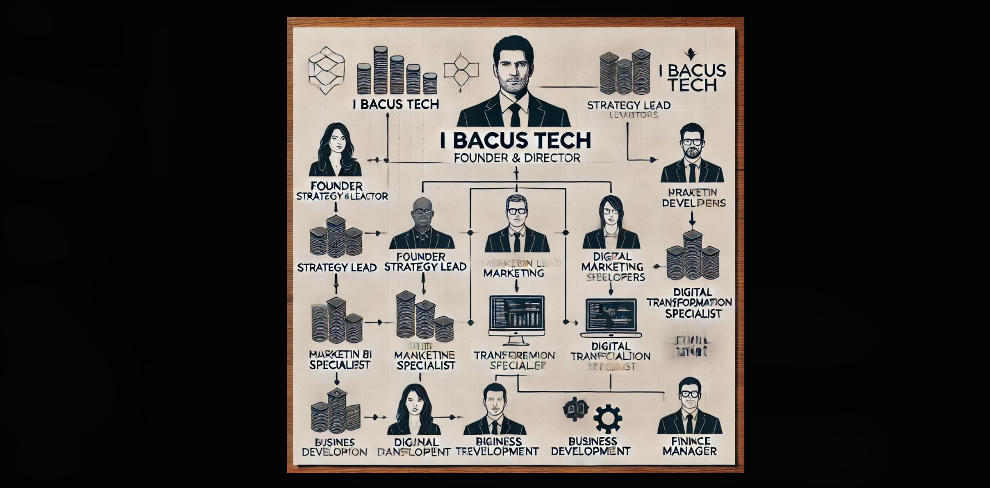
ORGANIZATIONAL STRUCTURE :

Slide 14
















CRM
WEB STORE
FINANCE
WORK COLLAB
GreeneStep provides an affordable ERP Platform that unifies a variety of business operations with outsourced IT.
Our customizable platform is accessible anytime anywhere, making it easy to manage your business right from the comfort of your own home.

Slide 15

Think New.
Think Green.
Think GreeneStep.
Premium Partner
About Us
Businesses are evolving faster than ever before, which is why it’s important to have an efficient system that automates, integrates, and facilitates collaboration between everyone form employees to vendors.
As an active thought leader in the industry, GreeneStep embraces these technological changes, by providing an integrated suite of solutions that help consolidate your company’s operations from all angles. By leveraging our powerful ERP platform and collaboration tools, business owners can run their business from anywhere.
GreeneStep helps businesses reduce their carbon footprint and digitize their operations seamlessly and efficiently.
With over two decades of techno-functional experience, GreeneStep has helped more than 130 valued customers worldwide, propelling their business to the next level with our state of the art solutions and services.
We strive to create a best in-class customer experience by empowering our customers to utilize our easily configurable and highly customizable platform to meet their needs.
We empower you so you empower your customers.
Learn more about the best integrated ERP, e-comerce and CRMx collaboration suite in the business.

Slide 16
The background of the study
My internship at I bacus Tech is at the forefront of this trend, focusing on providing innovative solutions that help businesses harness the power of their data. My internship provided me with hands-on experience in working with tools such as XMIND, Tableau, and Power BI, which are essential for transforming raw data into meaningful insights.
XMIND is a useful tool for brainstorming and organizing thoughts visually, making it easier for teams to communicate ideas effectively.
Power BI, developed by Microsoft, is an interactive data visualization tool designed to enable business users to create reports and dashboards without requiring advanced technical skills. Power BI’s integration with other Microsoft products like Excel, Azure, and SharePoint makes it particularly useful in organizations already utilizing these tools.
Tableau is another widely-used business intelligence and data visualization tool known for its powerful data analysis capabilities and intuitive visual representations. Its drag-and-drop interface allows users to quickly create complex visualizations and perform advanced analytics without requiring deep technical expertise.

Slide 17
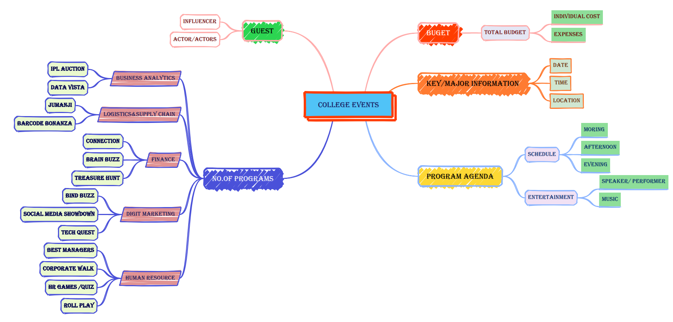
X MIND

Slide 18
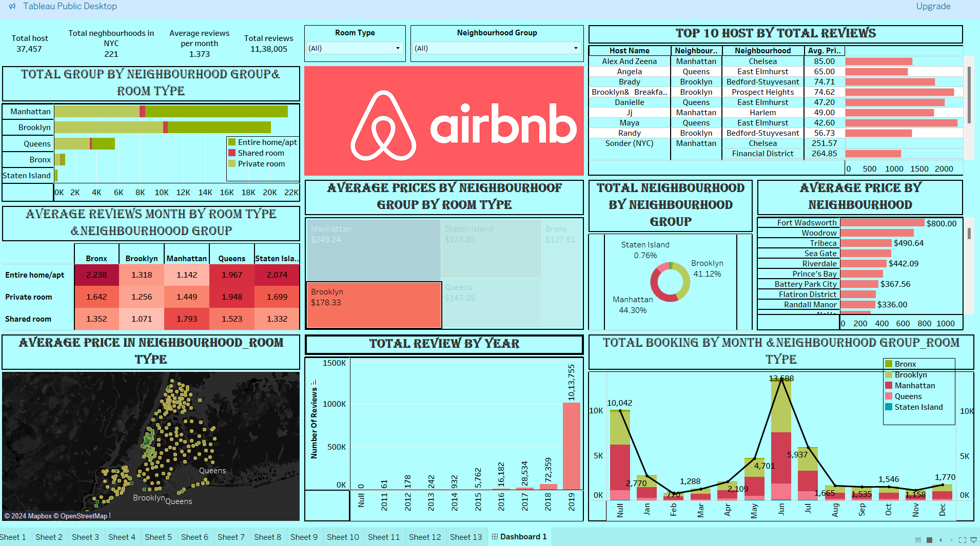
AIRNB DASHBOARD USING TABLEAU

Slide 19
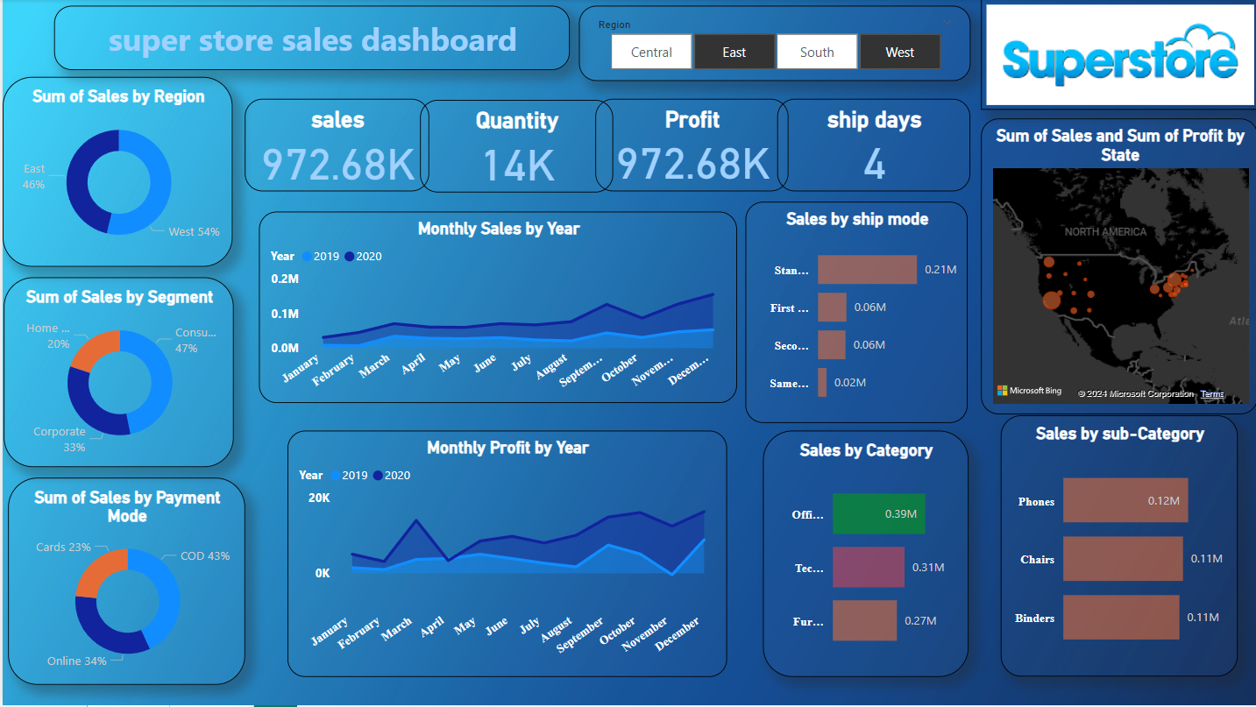

SALES DASHBOARD USING POWERBI

Slide 20
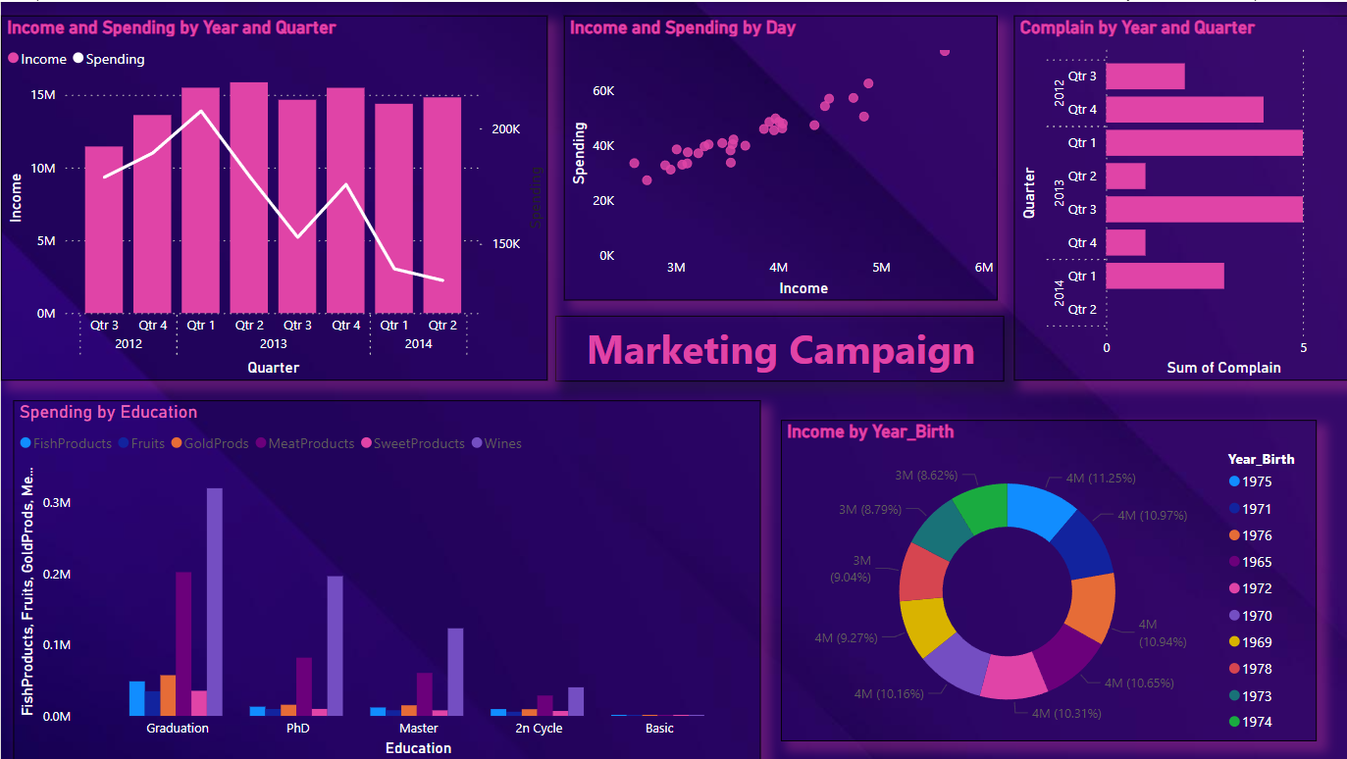
MARKETING CAMPAIGN DASHBOARD USING POWERBI

Slide 21
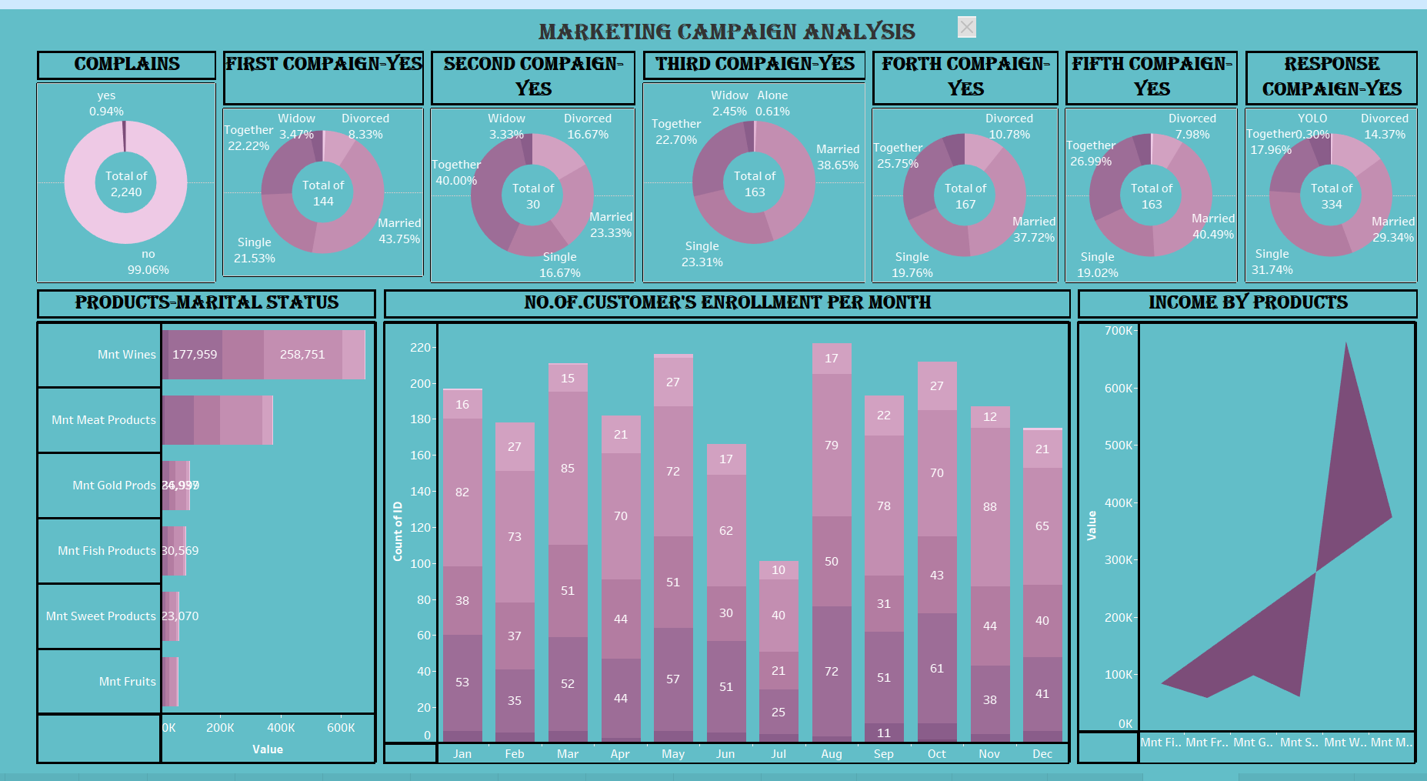
MARKETING CAMPAIGN DASHBOARD USING TABLEAU

Slide 22
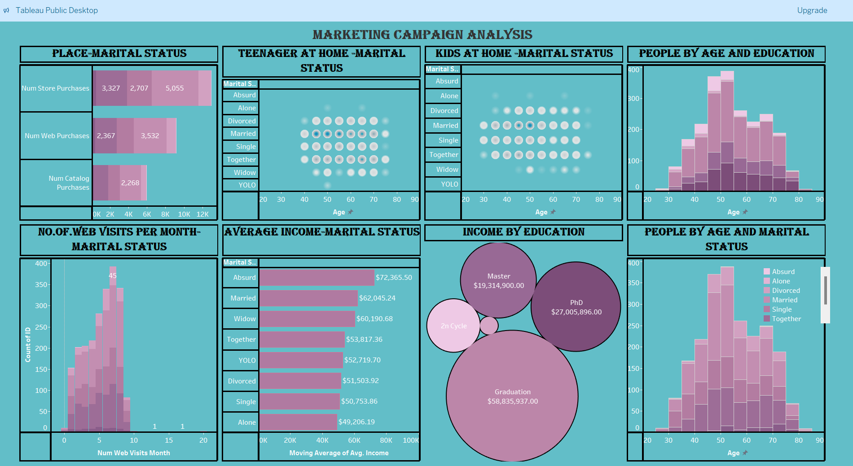
MARKETING CAMPAIGN DASHBOARD USING TABLEAU

Slide 23
Internship project in marketing campaign
CONTENT
Teenhome
Dt_Customer
Recency
MntWines
MntFruits
MntMeatProducts
MntFishProducts
MntSweetProducts
MntGoldProds
NumDealsPurchases
NumWebPurchases
NumCatalogPurchases
NumStorePurchases
NumWebVisitsMonth
AcceptedCmp3
AcceptedCmp4
AcceptedCmp5
AcceptedCmp1
AcceptedCmp2
Complain
Z_CostContact
Z_Revenue
Response

Slide 25


















CLI ENTS

